Slide 1
Retrieval Optimization
Test data generation
Metrics
TextSplitters
Embeddings

Slide 2
Test Data Generation
Get all pages from the 212 legal documents
For each page run QAGenerateChain to generate a question and an answer per page
Only questions are needed
Several times using different temperature and different models.
Generate {Question → Document} pairs. Document = Filename.page#
Each question has only one correct relevant document
Different from a “standard” IR (information retrieval) task where each query has multiple relevant documents

Slide 3
Questions Generation and Chunking
Questions
Pages
Chunks
Page 1
Chunk 11
Question 1
Chunk 12
Chunk 13
Page 2
Chunk 21
Question 2
Chunk 22
Chunk 23
Page 3
Chunk 31
Question 3
Chunk 32

Slide 4


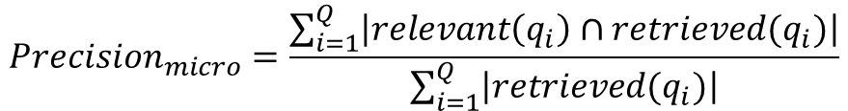
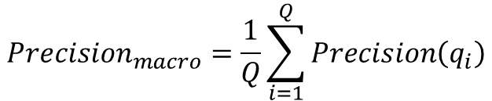
Retrieval Metrics
For multiple queries: macro precision/ macro recall and micro precision/micro recall
$${Precision}_{macro}=\frac{1}{Q}\sum_{i=1}^{Q}{Precision\left(q_{i}\right)}$$
$${Precision}_{micro}=\frac{\sum_{i=1}^{Q}{\left|relevant\left(q_{i}\right)∩retrieved(q_{i})\right|}}{\sum_{i=1}^{Q}{\left|retrieved(q_{i})\right|}}$$

Slide 5
Questions Generation and Chunking
Pages
Chunks
Questions
Page 1
Chunk 11
Chunk 12
Question 1
Chunk 13
Page 2
Chunk 21
Precision = 2/4 = 0.5
Recall = 2/3
Chunk 22
Chunk 23
Page 3
Chunk 31
Chunk 32
Are all chunks really relevant to the question?
The question was most likely generated using only subset of the text in the page.

Slide 6
Parent Document Retriever
Parent Documents (pages)
Child Documents (chunks)
Embeddings
Page 1
Chunk 11
Embedding 11
Chunk 12
Embedding 12
Chunk 13
Embedding 13
Page 2
Chunk 21
Embedding 21
Chunk 22
Embedding 22
Chunk 23
Embedding 23
Page 3
Chunk 31
Embedding 31
Chunk 32
Embedding 32
In general, parent documents can be done by text splitting with a greater chunk size, for the purpose of this project where the UI displays pages, it makes sense to use pages

Slide 7
Parent Document Retriever
Query
Embeddings
Embeddings
Child Documents (chunks)
Parent Documents (pages)
Embedding 11
Chunk 11
Page 1
Embedding 12
Chunk 12
Embedding 13
Chunk 13
Embedding
Page 2
Embedding 21
Chunk 21
Embedding 22
Chunk 22
Commonly used metrics Precision and Recall do not apply, since those metrics use the assumption that there are several relevant documents.
Embedding 23
Chunk 23
Page 3
Embedding 31
Chunk 31
Embedding 32
Chunk 32

Slide 8

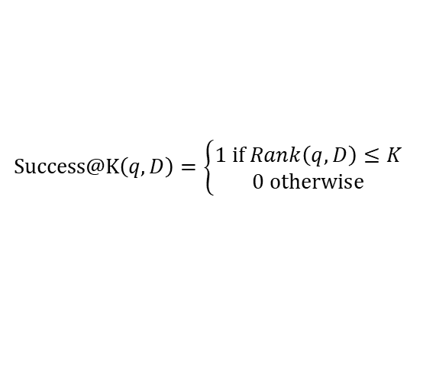

Retrieval Metrics
Mean Success@K
Mean Reciprocal Rank MRR@ K
Given document ranking D = [doc₁, …, doc_{N}] for a query q, Rank(q,D) is the position of the of the first relevant document for q in D
q₁
q₂
q₃
Success@K$\left(q,D\right)=\left\{\begin{aligned}1 if Rank\left(q,D\right)≤K \\ 0 otherwise\end{aligned}\right.$
Success@3(q₁, D)=1
RR@3(q₁,D)=1/1 = 1
doc₁
doc₁
doc₁
doc₂
doc₂
doc₂
RR@K$\left(q,D\right)=\left\{\begin{aligned}\frac{1}{Rank\left(q,D\right)} if Rank\left(q,D\right)≤K \\ 0 otherwise\end{aligned}\right.$
Success@3(q₂, D)=1
RR@3(q₂,D)=1/2 = 0.5
doc₃
doc₃
doc₃
doc₄
doc₄
doc₄
Success@3(q₃, D)=0
RR@3(q₃,D)=0
$$MRR@K=\frac{1}{Q}\sum_{i=1}^{Q}{\text{RR}\text{@}\text{K}\left(q_{i},D\right)}$$
doc₅
doc₅
doc₅
MeanSuccess@3=2/3
MRR@3=1.5/3 = 0.5
For some use cases, where the order of the retrieved documents matters, MRR@K is a more appropriate metric
For our use case, where the order doesn’t matter*, as long as the chunks are retrieved and passed to the LLM, Success@K is a more appropriate metric.
Alternatively, sum all of the relevant documents for K. Need to account for the fact that for smaller chunks this number will naturally be higher. Maybe divide by the chunk size
*The order may matter. If the chunks are returned in the same order they are found in the document may help LLM. However, that is harder to measure.

Slide 9
Text Splitter
Trade-off
Small chunk size
Has a better defined meaning, i.e. the embedding vector
Doesn’t have much information to use for LLM
Big chunk size
Doesn’t have a better defined meaning, the meaning is “washed-out”
Has much information to use for LLM
Solutions
Use many small chunks, downside the chunks are out of order and mixed with irrelevant chunks.
Parent Document Retriever, match a small sub-chunk, return the big parent chunk
Splitting parameters:
Chunk size
Chunk overlap
Separators (e.g. ['.' "\n", " ", ""]
Length function

Slide 10
Some Statistics

Slide 11
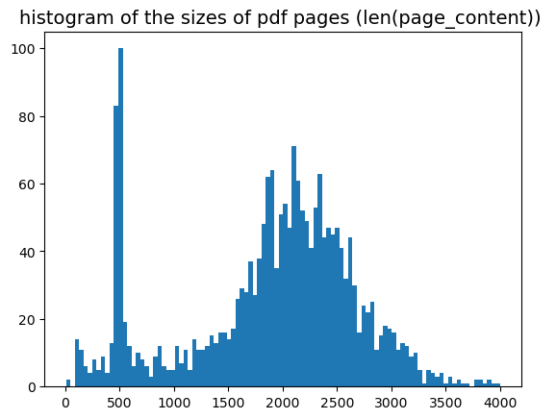
212 pdf files, 2059 pages

Slide 12
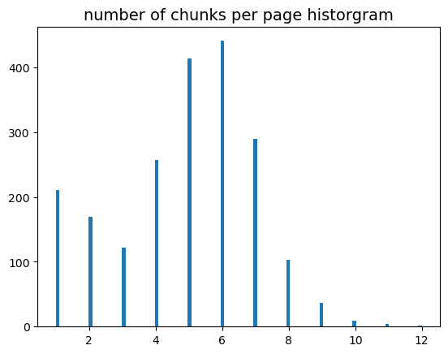
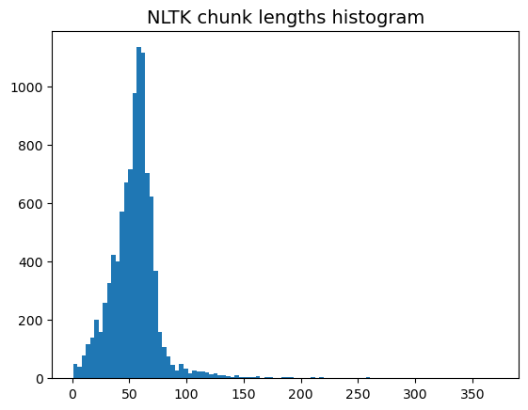
NLTK
text_splitter = NLTKTextSplitter(
chunk_size = 500,
chunk_overlap = 20,
separator='.',#, "\n", " ", ""]
length_function = len,
add_start_index = True,
)

Slide 13
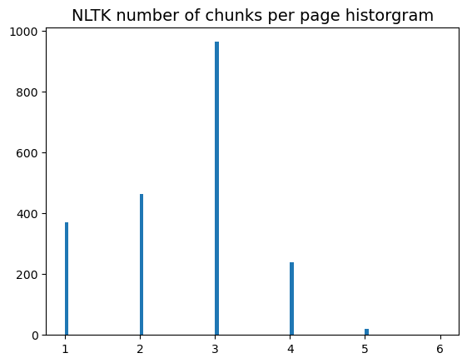
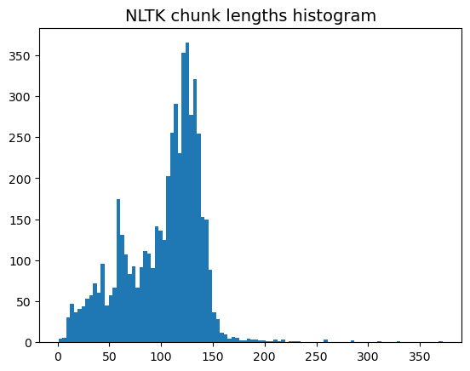
text_splitter = NLTKTextSplitter(
chunk_size = 1000,
chunk_overlap = 20,
separator='.',#, "\n", " ", ""]
length_function = len,
add_start_index = True,
)

